Slide 1


Slide 2


IMPRESSION MANAGEMENT
NON-VERBAL COMMUNICATION AND BODY LANGUAGE
FACIAL EXPRESSIONS AND GESTURES
Facial expressions - what is it?
Vital part of communication
Observable results of moving one or more facial muscles
Key - Relates to what you can observe

Slide 3
IMPRESSION MANAGEMENT
Three ways to have pleasant facial expressions
Being Aware of Your Face
Know how your face naturally rests
Ask other people
Learn to use the muscles of your face
Know your nervous habits

Slide 4
IMPRESSION MANAGEMENT
Making Changes
Practice at home and look engaged
Soften your eyes
Keep your mouth relaxed
Become pleasant within

Slide 5
IMPRESSION MANAGEMENT
Being Comfortable and Smiling
Smile when appropriate
Focus during uncomfortable situations
Have confidence in your appearance

Slide 6
IMPRESSION MANAGEMENT
Advantages and disadvantages of facial expressions
Advantages :
Can indicate sarcasm
Good for communicating silently
Can indicate hostility or friendliness
Good for flirting
Disadvantages :
Showing surprise or disgust - Not polite
Can show nervousness and vulnerability

Slide 7
IMPRESSION MANAGEMENT
Role of facial expression in social interaction
Multiple systems of emotion recognition
Emotional contagion
Explicit recognition of expressions
Emotions as communicative signals
Ostensive signals

Slide 8
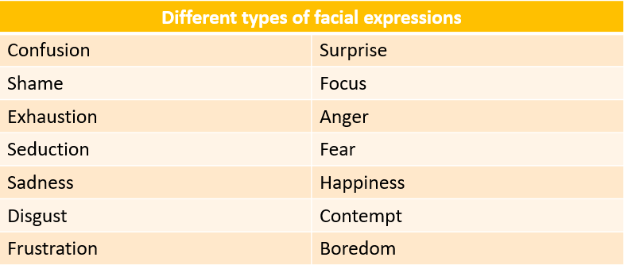
IMPRESSION MANAGEMENT

Slide 9
IMPRESSION MANAGEMENT
KINESICS
Kinesics - what is it?
Interpretation of body motion communication
Facial expressions and gestures
Nonverbal behaviour
Movement of any part of the body/body as a whole
Body language

Slide 10
IMPRESSION MANAGEMENT
Types of kinesics
Emblems:
Nonverbal cues that have a verbal counterpart
Regulators:
Non-verbal signs
Regulate, modulate and maintain the flow of speech
Different cultures use different forms of regulators
Illustrators:
Consistently to illustrate what is being said
Reinforces what you are saying
Different from culture to culture

Slide 11
IMPRESSION MANAGEMENT
Affective Display:
Body or facial movements - Display affective state
Different cultures practice - Display emotions
Two people may feel angry - Display of anger is different
Lack of display may not indicate the lack of emotions
Adaptors:
Postural changes - Low level of awareness
A slumped posture - Low spirits, fatigued
Erect posture - High spirits and confidence

Slide 12
IMPRESSION MANAGEMENT
Importance of positive body language
Sitting, legs crossed, and arms resting on the legs – Confidence
Critical evaluation –
Index finger – Covers mouth and thumb supports chin
Positive Body Language
Assertive Behaviour
Non-verbal Communication
Public Speaking

Slide 13
IMPRESSION MANAGEMENT
Forms of negative body language
Avoidance of eye contact
Nervousness, lack of confidence, low self-esteem or dishonesty
Staring
Intenseness and eagerness
Crossed arms
Separateness, discomfort, or defensiveness

Slide 14
IMPRESSION MANAGEMENT
Overuse of hands
Nervousness, excitement, or mania
Looking at watch, clock or phone
Boredom, anxiousness, impatience, or future-minded
Poor posture
Someone is not assertive or self-assured
Frowning
Sadness, sympathy, discontent, or anger

Slide 15
IMPRESSION MANAGEMENT
Summary:
Facial expressions - Vital part of communication
Pleasant facial expression - Small change - Positive affect on life
First be aware of your face
Small changes - Pleasant facial expression more consistent
Positive body language:
Helps people to be liked by other people
In an organization or community
Must for people across disciplines and ethnicities
Plays a pivotal role in :
Shaping our discussions
Relationships with other people in our daily life

